Slide 1



Data Science:
Finding Ideal Locations for Green Energy
Lena Kögel, Sönke Maibach, Gabriel Sacher, Simon Schad, Laura Marie Schiffers
25.09.2021 | Mentor: Amine Jebari | TechLabs Düsseldorf

Slide 2


Data Science:
Finding Ideal Locations for Green Energy
Lena Kögel, Sönke Maibach, Gabriel Sacher, Simon Schad, Laura Marie Schiffers
25.09.2021 | Mentor: Amine Jebari | TechLabs Düsseldorf

Slide 3






The Team Groovy Green Geeks
Sönke
Math & Statistics Teacher
Simon
Bachelor Business Administration
Laura Marie
Bachelor Business Administration
Gabriel
Master Business Analytics
Lena
Master Chemical Engineering
Amine
Mentor

Slide 4









Introduction Ideal Locations for Green Energy

Slide 5






Idea & Project Outline Project Idea
Analyze wind and solar data
Look at legal requirements as well as meterological data (wind speeds, sunlight hours, etc.) and consisting infrastructure (high voltage lines)
Show these locations a map (Highlight the best locations with a colour-ranking)
Optional: Calculate the amout energy that can be produced at a specific location
Optional: Calculate the break even-point
→ Goal: Recommend ideal locations for solar or wind parks

Slide 6
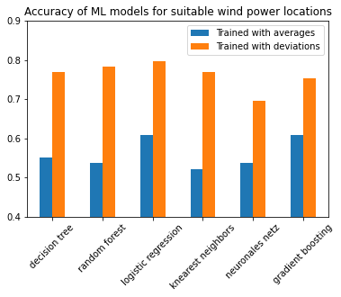

Problems & Solutions Improving model accuracy
Green Energy Locations | L. Kögel, S. Maibach, G. Sacher, S. Schad, L. M. Schiffers | 25.09.2021
6
Notes:
Trained machine learning models
Comparison by accuracy
Accuracy = how often is a prediction by the model correct
Calculated some average numbers, fed them to the model to predict wind power locations
Some models were as good as a coin flip, pretty much totally random
Tried to improve the models with the info from the exercises, trained 60 models, got accuracy up to 75% on average, but still wanted to improve
wind is a result of changing conditions, eg mainly changing temp
So we needed a number that reflects the range of changes for temp and other input data
Widely used standard deviation does that. Higher values typically means more and greater changes in conditions
Fed std data to model, instantly got accuracy of close to 80%
Easily better than optimized models based on averages
model training just got 50 times faster
Showed us:
Even a little bit of research and knowledge about specific problem can match or even beat sophisticated machine learning
Machine learning is perfect to find patterns, but the data has to include the real world patterns, otherwise can’t reach full potential

Slide 7
First Headline Second Headline

